Slide 1
EPA Metadata Editor v5.0
Presented by:
Ana Greene, EDG Program Manager, EPA, OEI
Catherine Harness, Innovate! Inc.
May 2017

Slide 2
Welcome
Introducing the new metadata editor – EME 5.0!
Purpose of the EME 5.0 is to make metadata editing easier and improve the quality of metadata records – as you create new metadata and edit old metadata use EME 5.0
No deadline for using the new tool
Feedback welcome!

Slide 3
Introduction to EME 5.0
EME 5.0 – What’s new?
Getting Started with EME 5.0
Validation Tips
ArcGIS Metadata, EDG & Data.gov
EME 5.0 - Demo
EME 5.0 - Important URLs

Slide 4
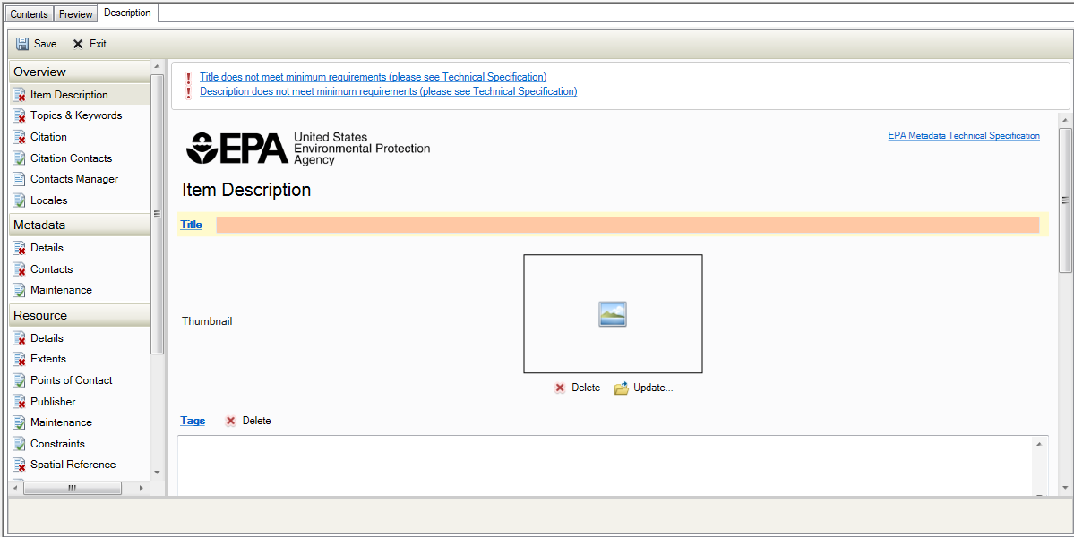
EME v5.0: What’s new?
EME v5.0 New Features:
It is integrated with Esri ArcGIS 10.4 and ArcCatalog metadata Editing Tools
Fully implements the ISO metadata standard
Metadata Field entries meet all Data.gov compliance requirements
EPA specific dropdowns provided for many fields
Mandatory fields highlighted
Notes:
EME 5 is EPA’s customization of Esri’s ArcCatalog metadata editor and creates ISO/POD-compliant ArcGIS Metadata. While EME 5.0 is quite a change from previous versions, we believe these changes will make creating EPA compliant metadata easier.
Some New Features found in EME 5.0 include:
Bullet 1 – Integration with Esri ArcGIS 10.4 and ArcCatalog metadata editing tools….it utilizes Esri’s ArcGIS metadata format.
Bullet 2 – The EME now fully implements the ISO metadata standard
Bullet 3 – Now Metadata Field entries meet all data.gov compliance requirements…reducing guess work when creating metadata
Bullet 4 – Many EPA specific dropdowns are provided for fields for faster metadata completion
Bullet 5 – Mandatory fields are highlighted to help eliminate validation errors

Slide 5
EME v5.0: What’s New?
Benefits of using EME 5.0:
Integration of metadata with geospatial datasets
Bounding box coordinates
Spatial reference
Spatial data representation
Attributes
Geoprocessing history
Real-time validation
Consolidation of records (only one metadata record required for all distribution methods):
Web service
Data download
Best practices guidance included in tool
Notes:
As Ana mentioned earlier there is no deadline or push to exclusively use EME 5.0 for your metadata creation and updates, I think it is important to explain the benefits of using EME 5.0 tools and how it can make your metadata creation easier. Here, I’ve listed some benefits to using EME 5.0.
1st, Since EME 5.0 is EPA’s customization of Esri’s ArcGIS metadata tools, it allows for better integration of metadata with Geospatial datasets. Many metadata fields auto-populate when documenting geospatial datasets. There is no longer the stress of trying to understand and manage the EME synchronization settings. I know that was a headache for many in the past…now this is all done automatically when you select your geospatial dataset for editing. Some of the fields that are automatically populated include…bounding box coordinates, spatial reference, spatial data representation, attributes, and geoprocessing history.
2nd The ArcCatalog Editor provides real-time validation, and the EME 5.0 has refined that validation to comply with EPA and Project Open Data Standards. validation occurs as edits are made….you no longer need to run a separate validation tool to find out where you need to make changes due to validation errors.
3 - previous versions of EME have followed FGDC CSDGM metadata standards which necessitated creating two separate metadata documents when documenting a web service and corresponding data download file. EME v5.0 allows for consolidation of the web service and data download records into one metadata record due to implementation of the ISO 19115 metadata standard and improved functionality when documenting online linkage formats.
4 – Lastly, you can now view best practice guidance directly from the Tool. You no longer need to look on the EME website to find guidance documentation. I will show you later in the presentation how this new guidance has been incorporated into the tool and how you use it. I really like this particular feature! It makes finding help for a specific metadata field very easy!

Slide 6
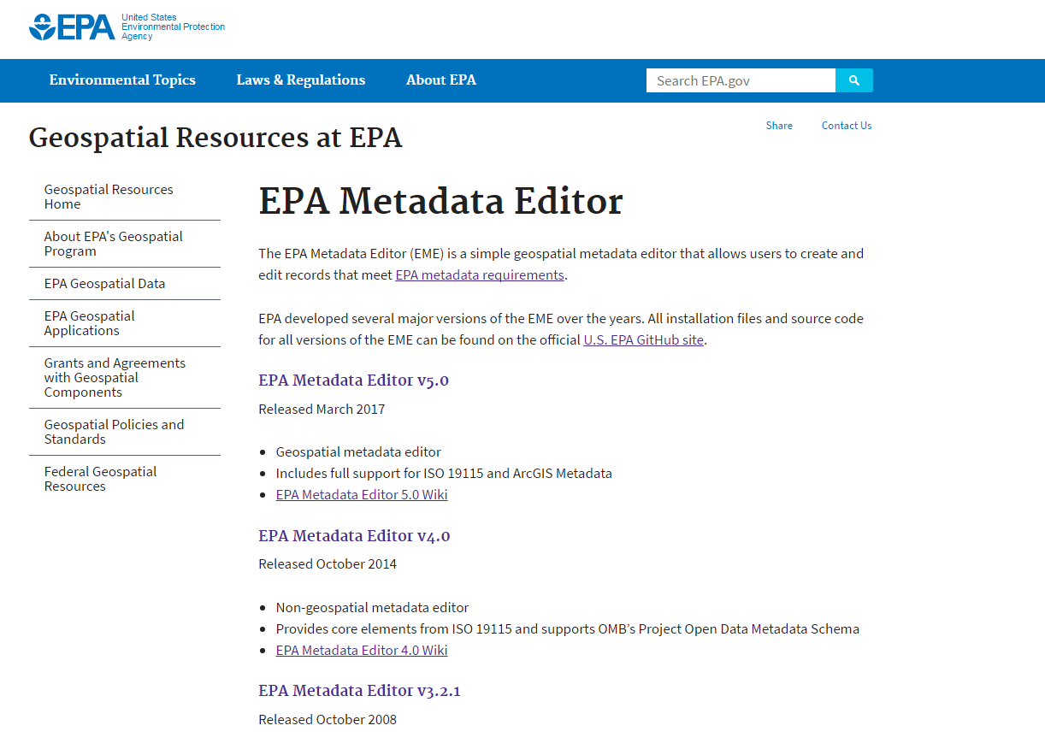
EME v5.0: Getting Started
Download EME 5.0:
Visit New EME Website!
Download Installation package
Notes:
Now we’re going to take a look at getting started using EME 5.0
We have created an EME 5.0 Repository in EPA’s GitHub site to store the EME Installation packages and reference materials.
I’m going to quickly show you all the new EME github site….

Slide 7
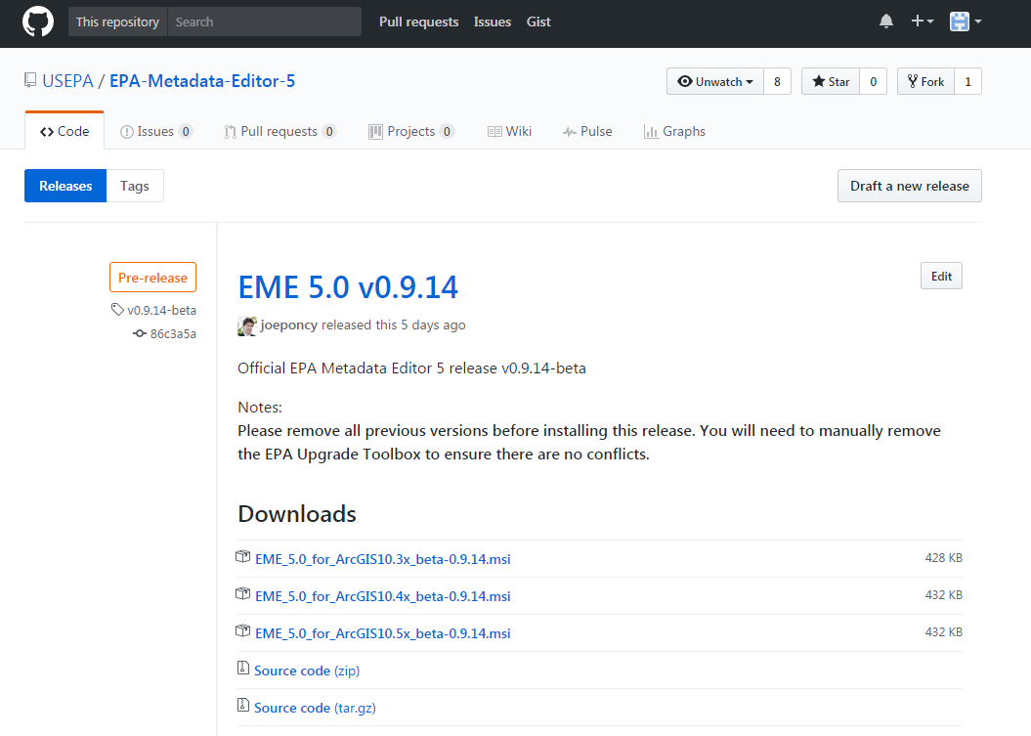
EME v5.0: Getting Started
Installing EME 5.0:
Uninstall old versions of EME 5.0
Run the installation file
It is not necessary to uninstall versions of EME prior to 5.0
Note: You may receive a security notice when installing EME 5.0, this can be ignored. The install package was scanned and no risks were identified.
Notes:
Once you’ve gone to the EME 5.0 release page and downloaded the installation package, you will want to run the install file.
2 – If you previously had a copy of EME 5.0 installed, please use the control panel to uninstall it first. We are still working on including a utility that will upgrade/overwrite previous versions. It is not necessary to uninstall versions of the EME prior to 5.0.
Install Security Notices: Your security and firewall software may filter or flag this extension during install process. While EPA certifies this package comes from a trusted source, it was deemed judicious to conduct additional testing. This install package was scanned for risks using Symantec™ Endpoint Protection software on January 13, 2017 and No risks were identified.

Slide 8
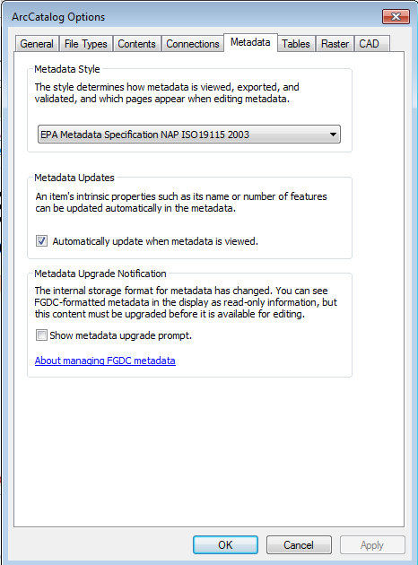
EME v5.0: Getting Started
Enable New EME Tools:
Open ArcCatalog → Customize menu → ArcCatalog Options → Metadata
Select EPA Metadata Specification NAP ISO 19115 2003 as your Metadata Style
Uncheck box “Show metadata upgrade prompt”
Notes:
After you’ve run the install program, you will need to enable the new EME tools. To do this…
Open ArcCatalog → Customize menu → ArcCatalog Options → Metadata
Select EPA Metadata Specification NAP ISO 19115 2003 as your Metadata Style
Uncheck box “Show metadata upgrade prompt” – We recommend not using Esri's default Upgrade tool and have provided an improved alternative which I will review later in this presentation.

Slide 9
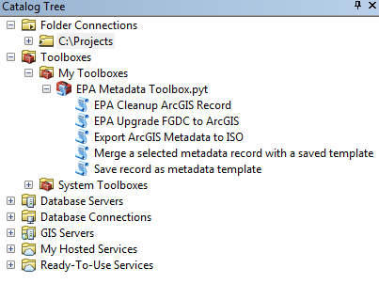
EME v5.0: Getting Started
EPA Metadata Toolbox:
Appears in “My Toolboxes” folder in the Catalog Tree
Contains 5 Tools:
EPA Cleanup ArcGIS Record
EPA Upgrade FGDC to ArcGIS
Export ArcGIS Metadata to ISO
Merge a selected metadata record with a saved template
Save record as metadata template
Notes:
EME 5.0 includes an EPA Metadata toolbox containing 5 tools. The toolbox will appear in the “My Toolboxes” folder in the Catalog Tree.
Now we will take a look at each of the 5 tools in more detail.

Slide 10
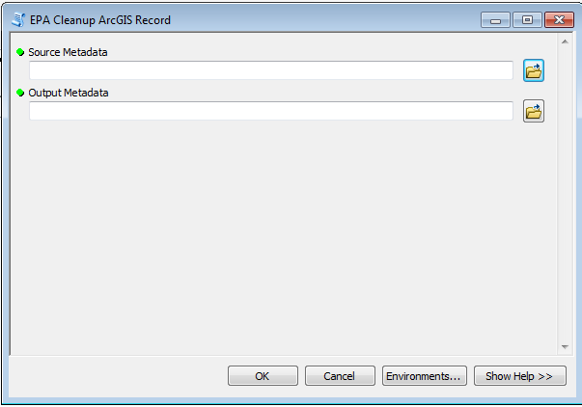
EME v5.0: Getting Started
EPA Metadata Toolbox: EPA Cleanup ArcGIS Record
For use when a metadata record has already been upgraded from FGDC CSDGM to ArcGIS format using the default Esri Upgrade Metadata tool.
Notes:
First we have the EPA Cleanup ArcGIS record tool. This tool is to be used when metadata record has (deliberately or inadvertently) already been upgraded from FGDC CSDGM to ArcGIS format using the default Esri Upgrade Metadata tool. This tool was developed to help better align such a record with the EPA Metadata Technical Specification.

Slide 11
EME v5.0: Getting Started
EPA Metadata Toolbox: EPA Upgrade FGDC to ArcGIS
Used to upgrade all legacy FGDC CSDGM records to ArcGIS format.
Aligns records with the EPA Metadata Technical Specification
Ensures embedded UUIDs are recognized
Removes legacy elements
Notes:
Next we have the EPA Upgrade FGDC to ArcGIS tool This tool should be used to upgrade all legacy FGDC records to ArcGIS format. If you are updating an FGDC record, you will want to first run the record through this tool.
You may wonder why this tool is necessary since ArcGIS contains a metadata upgrade tool by default. This tool is necessary because the standard Esri upgrade process fails to incorporate embedded UUIDs (even though they use Esri tags) and leaves many legacy FGDC elements in the document that aren't visible in the editor and thus aren't being maintained…so, this tool will help align records with the EPA Metadata Technical Specification, ensure that embedded UUIDs are recognized and legacy elements are removed.
This tool produces a standalone metadata document that we recommend you review thoroughly before you replace your old metadata document. This tool may be run in batch mode, upgrading a whole bunch of documents at once - provided you specify an output filename for each.

Slide 12
EME v5.0: Getting Started
EPA Metadata Toolbox: Export ArcGIS Metadata to ISO
Streamlines exporting ArcGIS metadata to compliant ISO 19115
Equivalent to using the Export Metadata tool with ArcGIS2ISO19139 as the translator
Notes:
The 3rd tool is the Export ArcGIS Metadata to ISO. This tool streamlines exporting ArcGIS metadata to compliant ISO 19115. It is equivalent to using the Export Metadata tool with ArcGIS2ISO19139 as the translator.
we don’t anticipate asking anyone to produce ISO 19115 documents as part of their normal workflow for getting metadata into the EDG or EPA GeoPlatform. This tool is only if you have some other request for a standalone ISO 19115 version of your metadata. EDG will perform the conversion of all ArcGIS Metadata to ISO 19115 for submission to data.gov

Slide 13
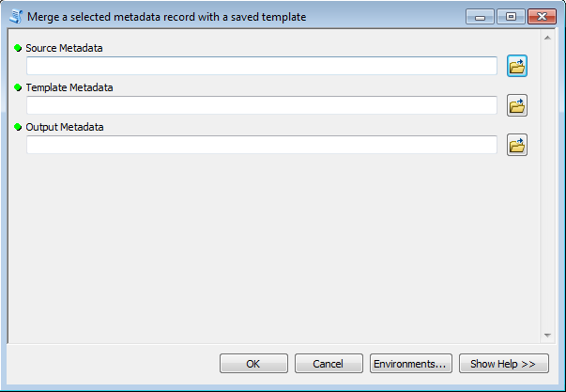
EME v5.0: Getting Started
EPA Metadata Toolbox:
Merge a selected metadata record with a saved template
Merges a selected metadata record with elements from a saved template
Elements from the template record will overwrite their equivalents in the selected record
Replaces only those elements that are common across many records
Note: caution is urged when using this tool
Notes:
The 4th tool is the Merge a selected metadata record with a saved template tool. This tool merges a selected metadata record with elements from a saved template record. Elements from the template record will overwrite their equivalents in the selected record, but by design it will exclude those elements which must be unique in every metadata record, such as title, abstract, unique identifier, etc, replacing only those elements that are common across many records. Still, caution is urged when using this tool. It produces a new standalone document rather than updating your metadata in-place b/c we want you all to carefully review the output before replacing your source metadata.

Slide 14
EME v5.0: Getting Started
EPA Metadata Toolbox: Save record as metadata template
Saves a metadata record as a reusable template
Excludes elements that are unique in every record
Examples:
Title
Abstract
UUID
Keeps common elements
Examples:
Metadata Contact
Publisher
Distribution Contact
Notes:
Lastly we have the Save record as metadata template tool. This tool saves a metadata record as a reusable template by excluding those elements which must be unique in every metadata record, such as title, abstract, unique identifier, etc, leaving those elements that are common across many records such as metadata contact, publisher, and distribution contact.
One thing I want to note here is that the output template is not a full/complete document, it’s only a fragment, so you shouldn’t expect it to pass validation.

Slide 15
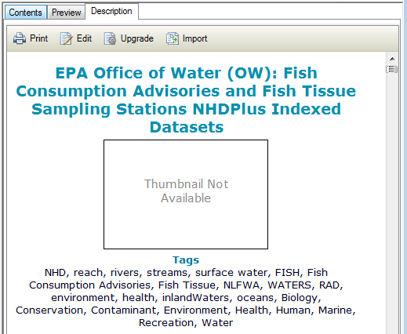
EME v5.0: Getting Started
EME 5.0 Interface :
To Edit Metadata using EME 5.0
Navigate to an XML file or a GeoSpatial Dataset and click the Description Tab
Allows viewing of metadata records in ArcGIS metadata format
Notes:
Now we’re going to take a close look at the new EME 5 interface. It is quite different from previous versions of the EME.
The first step to editing metadata in EME 5.0 is to locate either the Geospatial Dataset or standalone XML file within ArcCatalog you wish to edit and click the description tab.

Slide 16
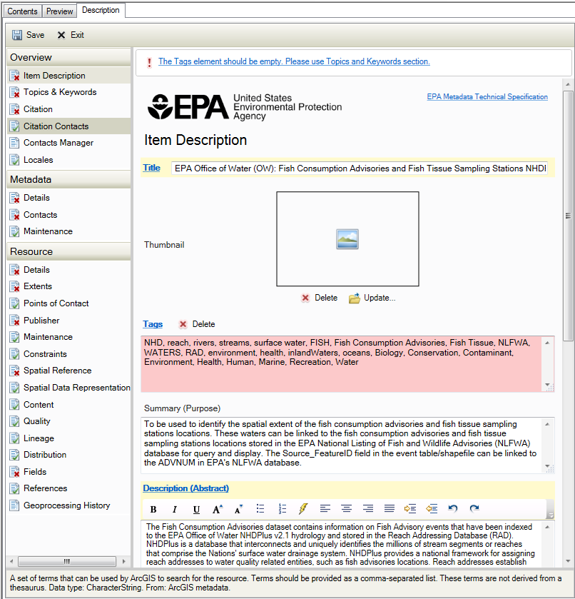
EME v5.0: Getting Started
EME 5.0 Interface :
To Edit Metadata using EME 5.0
2. Click the Edit button
Opens EME 5.0
Notes:
Once you’ve selected the record you’d like to edit and have it open in the description tab of ArcCatalog, click the Edit button. This will open the EME 5 editor. You will know you’re using EME 5.0 b/c you will see the EPA logo at the top of the Editing pane.

Slide 17
EME v5.0: Getting Started
EME 5.0 Interface :
Organized within ArcCatalog in a Table of Contents
Clicking on a page in the table of contents displays a set of metadata fields in the Editing pane
Table of Contents containing pages to be edited
Editing Pane
Notes:
The EME interface is designed with a table of contents on the left and an editing pane on the right. By clicking on a page in the table of contents, a set of metadata fields displays in the editing pane.
Show with using your cursor…

Slide 18
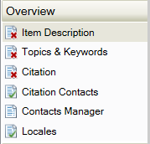
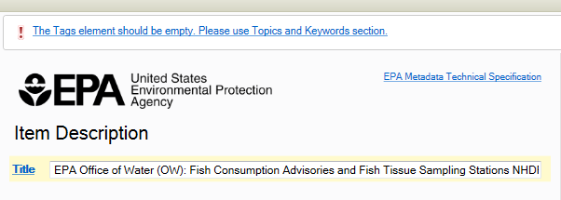
EME v5.0: Getting Started
EME 5.0 Interface :
Pages in the Table of Contents, symbolized with a Red X illustrate an error in the corresponding metadata fields
Help text is found at the top of the Editing pane indicating the fields in the selected page that do not meet minimum metadata requirements
Notes:
Pages in the Table of Contents, symbolized with a Red X illustrate an error in the corresponding metadata fields
Help text is found at the top of the Editing pane indicating the fields in the selected page that do not meet minimum metadata requirements
These messages are designed to link directly to the individual problem fields when clicked, but due to a known Esri bug, most of the time clicking on the links does nothing.
Although Esri has acknowledged the bug and our frustrations we unfortunately don’t anticipate a fix anytime soon.

Slide 19
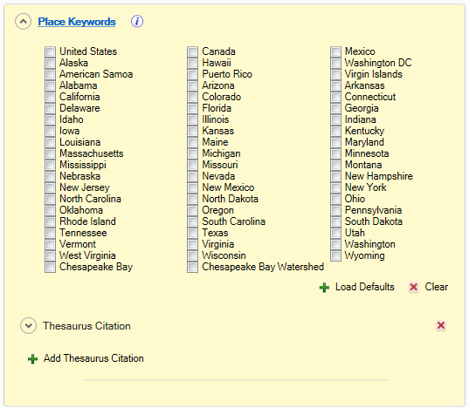
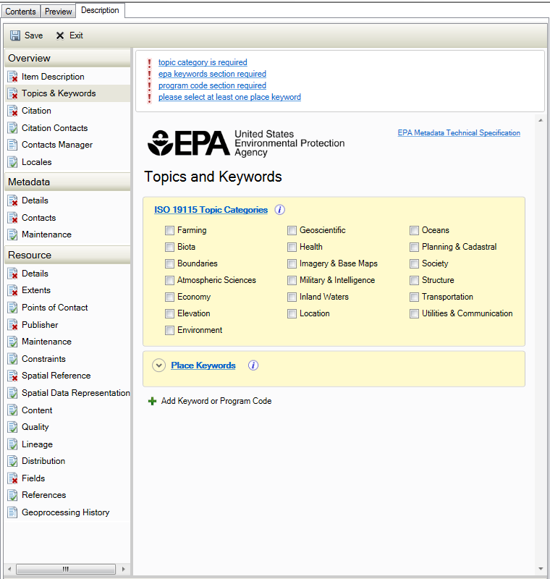
EME v5.0: Getting Started
EME 5.0 Interface :
Errors may not be immediately visible and instead a section needs to be expanded to find the element error.
Dropdown arrow opens an expandable section
Notes:
Here I want to point out that you need to be aware that because of the expandable sections in the editing pain it is possible that element errors may not be visible at first glance.
In this example, our metadata record has a validation error stating, “please select at least one place keyword”. In our editing pane, we see the field “Place Keywords” but we do not immediately see why we would be receiving an error message. We need to click the dropdown arrow to open the expandable section. Once the section is expanded, we see that no “place keyword” has been selected. To resolve the error we click on the boxes next to the “place keywords” that are appropriate for our data. Since EME 5.0 uses real time validation, when we add “place keywords” the error message will no longer appear at the top of our editing pane for the Tag and Keywords page.

Slide 20
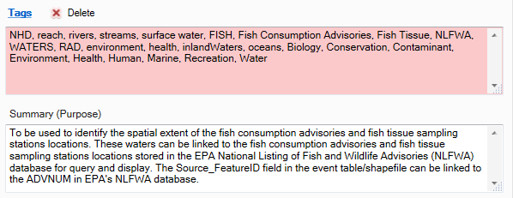
EME v5.0: Getting Started
EME 5.0 Interface :
Invalid text fields needing correction are shaded in pink or peach within the Editing pane
Note: dropdown and date fields do not support this coloring
Notes:
Here I’d like to point out that Invalid text fields needing correction are shaded in pink or peach within the editing pane
note that dropdown and date fields do not support this coloring

Slide 21
EME v5.0: Getting Started
EME 5.0 Interface :
Mandatory metadata fields are shaded in light yellow.
Note: mandatory fields may not be visible at first glance, because it is possible they are found in an expandable section
Notes:
Here we see that Mandatory fields are shaded in light yellow. (this is similar to older versions of the EME0 Again, on many pages the mandatory field is immediately visible within the editing pane. However on some pages, the mandatory field may be hidden in an expandable section.
Completing the fields shaded in light yellow within each EME table of contents page creates ISO/POD-Compliant ArcGIS metadata.

Slide 22
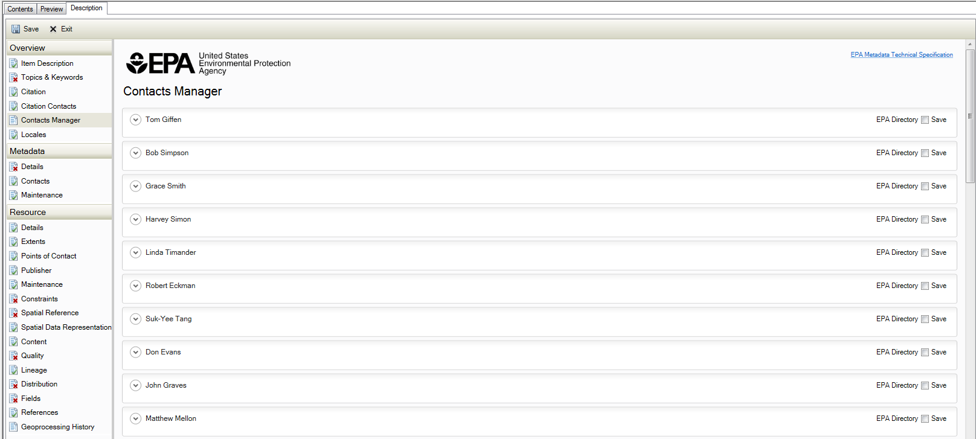
EME v5.0: Getting Started
Contacts Manager:
Provides a list of pre-populated EPA Contacts
Lists any contacts that are included in the current metadata document
Local Contacts file can be shared with Colleagues
Note: Contact Details cannot be edited in the Contacts Manager page
Notes:
Now we’re going to take a look at the contact information using the contacts manager. This is very different from using the old EME database. I will show you all how to make the changes during the demo portion of the presentation. Here I want to point out what is provided with the new contacts manager.
Shows any contacts that are included in the current metadata document, along with any contacts you’ve saved to your local Contacts File. (found here:
My Documents\ArcGIS\Descriptions\contacts.xml)
Provides a list of pre-populated EPA Contacts.
Local Contacts file can be shared with colleagues
Contact details cannot be edited in the Contacts Manager Page.

Slide 23
EME v5.0: Getting Started
Contacts Manager – Editing Contacts:
Add contact to the metadata document in one of the following locations:
Citation Contacts
Metadata Contacts
Resource Points of Contact
Select the name of the metadata contact from the dropdown list and click Load.
Notes:
To Edit a contact, you must first add them to the metadata document in one of the following locations:
Citation Contacts
Metadata Contacts
Resource Points of Contact
Once in one of the above sections, you load a contact by selecting the name of the metadata contact from the dropdown list and click Load.

Slide 24
EME v5.0: Getting Started
Contacts Manager – Editing Contacts:
When a contact is loaded, you can expand the section by clicking each down arrow
Notes:
When a contact is loaded, you can expand the section by clicking each down arrow which provides access to the full set of contact fields.

Slide 25
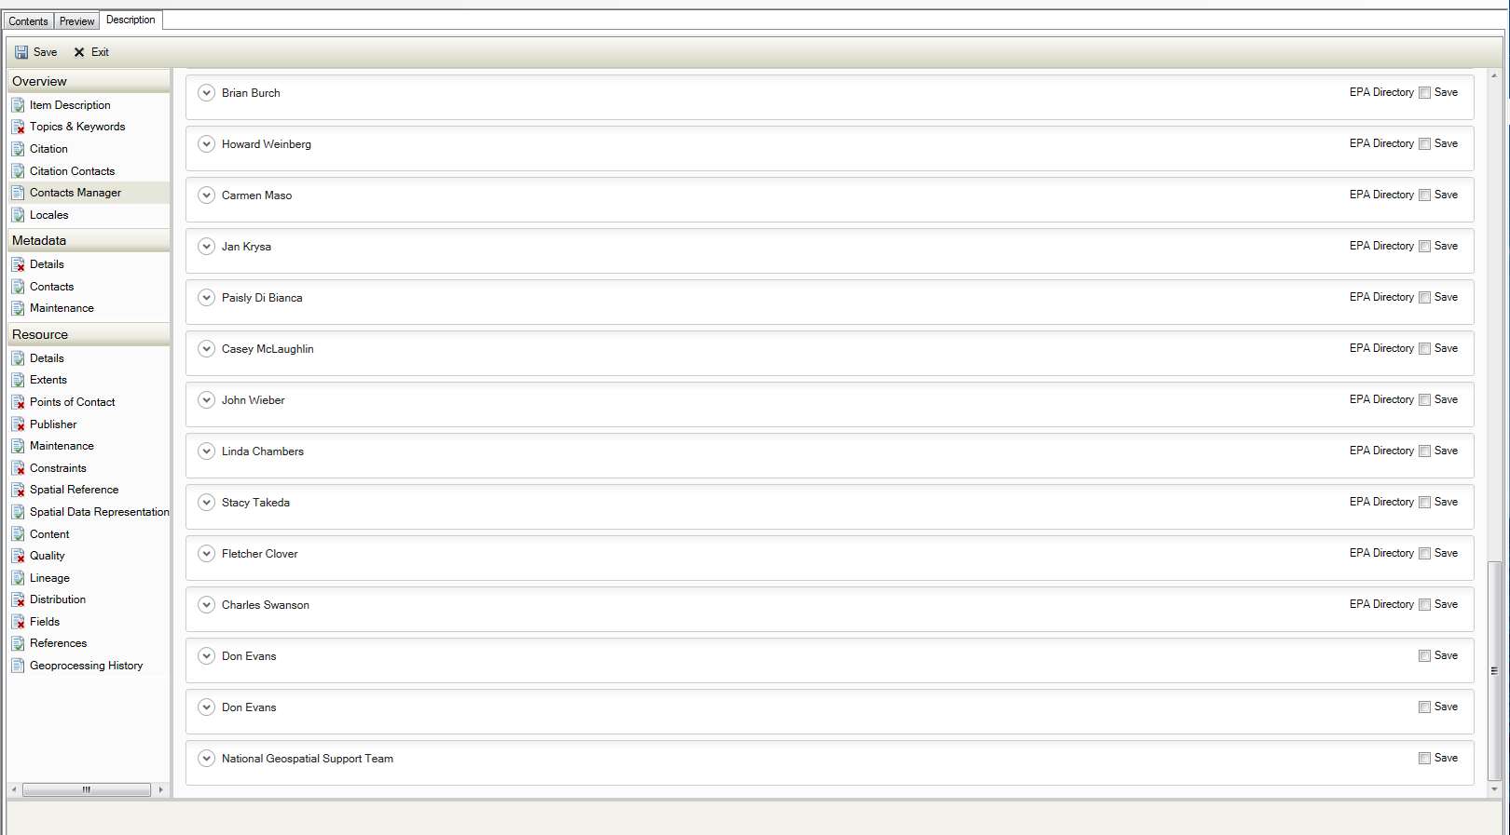
EME v5.0: Getting Started
Contacts Manager – Editing Contacts:
New version of contact will appear at the bottom of the Contacts Manager Page
Notes:
New version of contact will appear at the bottom of the Contacts Manager Page

Slide 26
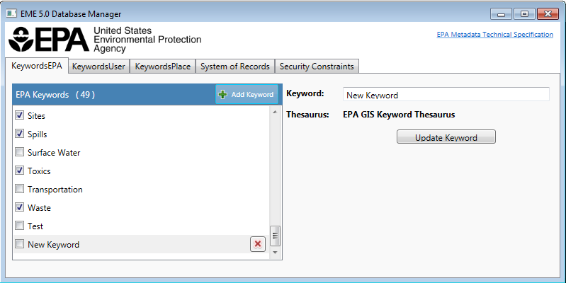
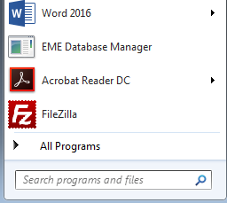
EME v5.0: Getting Started
Database Manager
No longer an MS Access Database
Standalone Application found in Start Menu
Used to manage Keywords, System of Records, and Security Constraints fields
Notes:
The new Database manager is also quite different from previous versions of the EME. The EME no longer users an MS Access Database, it is now a Standalone Application found in the Start menu. The database manager is used to manage Keywords, System of Records and Security Constraints. During the demo, I will show you all how to access and use the EME 5.0 Database manger.

Slide 27
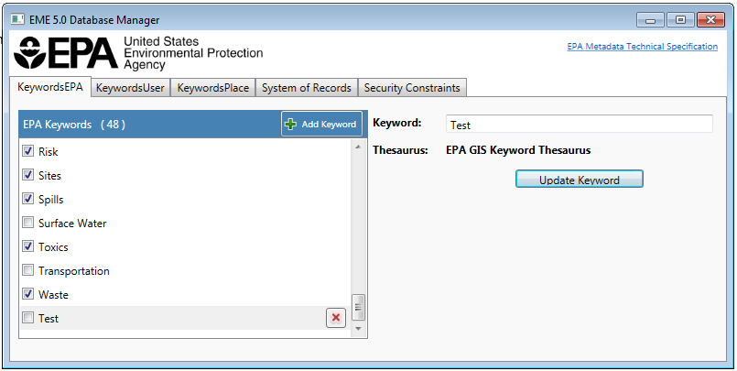
EME v5.0: Getting Started
Database Manager – Editing Defaults
Click Add Keyword or Add Constraint (depending on tab)
Add Keyword or Constraint in text box and click Update
New entry appears at the bottom of the defaults list

Slide 28
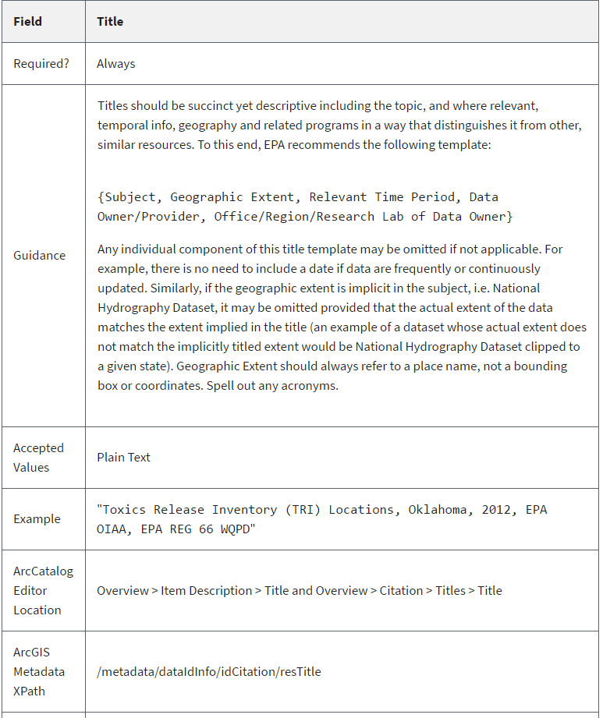
EME v5.0: Getting Started
EME 5.0 Help:
Mandatory fields link directly to their detailed guidance in the EPA Metadata Technical Specification.
A link to the complete EPA Metadata Technical Specification can be found in the top right corner of the Editing pane.
Notes:
Now let’s take a look at the different ways you can find help within EME 5.0. If you have questions about a mandatory field high lighted yellow). click on the mandatory field name and you will be linked directly to that field’s reference in the EPA Metadata Technical Specification where you will find detailed guidance and examples for that particular field.
Here I have clicked on the mandatory field “Title” and the EPA Metadata Technical Specification website has opened to the section for the field “Title”
You can also at anytime during an editing session, open the complete EPA Metadata Technical Specification by clicking on the link in the upper right hand corner of the EME 5 editing pane.

Slide 29
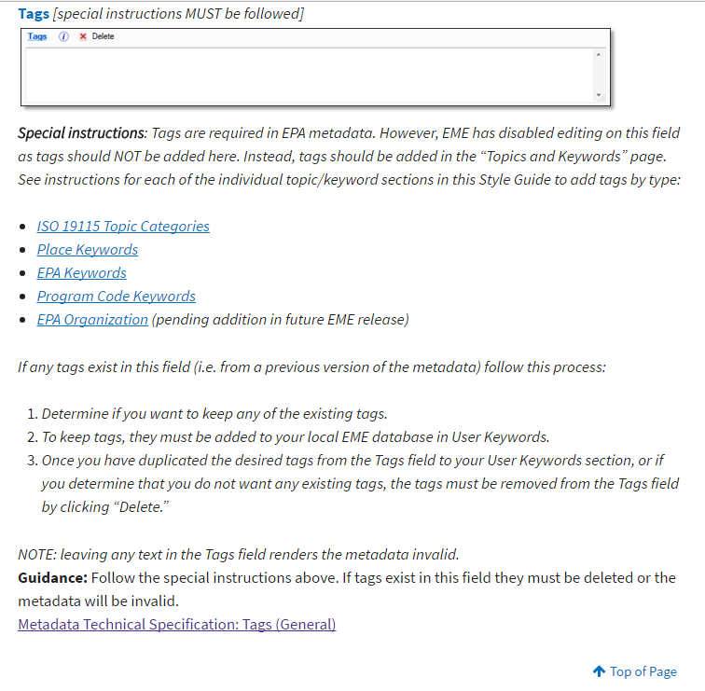
EME v5.0: Getting Started
EME 5.0 Help:
The icon next to a field name links directly to that field’s detailed guidance in the EPA Geospatial Metadata Style Guide using EME 5.
Notes:
In addition to finding help using the EPA Metadata Technical Specification, most mandatory fields also have a direct link to their entry in the EME 5.0 Style Guide. If you need instructions or suggestions for appropriate field entries, click on the “i” icon next to a the field name. This opens the EME 5.0 style guide which provides detailed information on how to complete a field in order to meet EPA and ISO/POD compliant ArcGIS metadata. As I mentioned earlier, now you no longer have to go out to the EME website and search for the style guide, open it and then search the entire document for the field you needed help completing. I have found this new way of accessing the Metadata Tech Spec and style guide to be immensely beneficial and hope you all utilize these options when needing assistance for a particular mandatory metadata field.

Slide 30
EME v5.0: Validation Tips
Validation Tips:
When edits are made EME 5.0 automatically updates the “Date Stamp” field.
Do not use the “Validation” button when validating metadata (it happens in real time)
Do not include “Tags” in the Item Description page. Include them in the Topics and Keywords page
Make appropriate Program Code selection from the OMB list within the Topics and Keywords page.
More Validation Tips can be found on the EME 5.0 wiki
Notes:
In previous versions of the EME, you had to manually update the metadata last update date. EME v5.0 will update the date stamp automatically when any edits are made to the metadata. So you no longer have to remember to update that date before saving your metadata.
2nd Do not use the validation button found in ArcCatalog’s metadata toolbar. EME’s validation occurs in real time so there is no need to “validate” using a separate tool.
Tags are required in EPA metadata. However, we have disabled editing on this field in the item description page…b/c tags should NOT be added here. Instead, tags should be added in the “Topics and Keywords” page. We have included detailed directions on how to add tags to the Topics and Keywords page in our EME 5.0 style guide. You can get to these directions by clicking on the “I” icon next to the field name Tags on the “item Description page”.
Program code has always been "mandatory" per data.gov, but it was not possible to include a program code in FGDC CSDGM records, and the EDG assigned all FGDC metadata a program code of 020:072 - IT/ Data Management. With ISO it is possible, and we are asking stewards to make an appropriate selection from the OMB list
More Validation Tips can be found on the EME 5.0 Github wiki

Slide 31
EME v5.0: ArcGIS Metadata, EDG & Data.gov
ArcGIS Metadata, EDG and Data.gov
EDG Handles ArcGIS Metadata records the same as FGDC CSDGM records
Can be harvested to the EDG from the same Web Accessible Folders
Appearance within EDG will be similar to old records
EDG performs a transformation on records to put them in ISO 19115 for data.gov harvests
Will improve behavior and appearance at data.gov
Notes:
Last but not least, I wanted to mention how ArcGIS metadata, the EDG and Data.gov worked together now that we’re making big changes to how we create metadata.
So, EDG Handles ArcGIS Metadata records the same as FGDC CSDGM records
Your metadata records can be harvested to the EDG from the same Web Accessible Folders as they have in the past.
Your metadata will Appear very similar to your old records within the EDG when searching and discovering records.
Behind the scenes, EDG performs a transformation on records to put them in ISO 19115 for data.gov harvests
This process will improve the behavior and appearance of your records at data.gov

Slide 32
DEMO

Slide 33
EME v5.0: Important URLS
Download EME 5.0 –
https://github.com/USEPA/EPA-Metadata-Editor-5/releases
EME 5.0 Fact Sheet –
https://edg.epa.gov/data/Public/OEI/EMEv5Files/EME5_FactSheet_20170306.pdf
EME 5.0 Installation Guide –
https://github.com/USEPA/EPA-Metadata-Editor-5/wiki
EME 5.0 Metadata Style Guide -
https://www.epa.gov/geospatial/epa-geospatial-metadata-style-guide-using-eme-5
Questions/Help, email: edg@epa.gov
Notes:
Before Handing the presentation back to Ana for Questions, I wanted to mention several important URLs. To download EME 5.0, Go to the EME 5 site. Here you will also find the EME 5.0 Fact sheet and EME 5.0 Installation Guide. I have also included the link to the complete EME 5.0 Style Guide website. If you have any questions or need help please contact the EDG Admin group at edg@epa.gov.
Ana, I’ll pass the presentation back to you for Questions. Thanks, everyone.

Slide 34
Questions?
Ana Greene
EDG Program Manager
Greene.Ana@epa.gov

